Slide 1
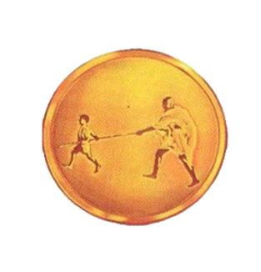
Presentation on “UNDERWATER ROV”
Mahatma Gandhi Mission’s College of Engineering and Technology,
A-9,Sector-62,Noida-201301
Affiliated to
Dr.A.P.J. Abdul Kalam Technical University,Lucknow
GUIDED BY:
Mrs. Poonam Yadav
SUBMITTED BY:
Naman Sharma
Sushant Gupta
Kuldeep Singh Parihar
Sonu Jha

Slide 2
TABLE OF CONTENT
INTRODUCTION
OBJECTIVE
LITERATURE SURVEY
HARDWARE DISCRIPTION
SOFTWARE DISCRIPTION
PHYSICAL 3D MODEL
BLOCK DIAGRAM
FLOW CHART
IMPLEMENTATION
ADVANTAGE
APPLICATION
FUTURE SCOPE
GANTT CHART
REFERENCES

Slide 3
INTRODUCTION
The project “UNDERWATER ROV” targets the aquatic or marine region for its working.
This project is basically a drone that has its operation inside the water body.
Remotely operated underwater vehicles (ROVs) are remote control underwater robots driven by an individual on the surface.
The ROVs will be equipped with a video camera, propulsion system, and lights.
The propulsion system is responsible for the movement of the ROV in the water.

Slide 4
OBJECTIVE
This project is designed to dive inside the water body and acquire the information user needs.
The project can provide information regarding the various aquatic species or to assist in search and rescue operations.
Other than this, the project can also be used for underwater videography and to assist the divers.

Slide 5
LITERATURE SURVEY
[1]Wireless Controlled Remotely-operated Underwater Vehicle (ROV) for Shallow Water Exploration
Authors-Muhammad Ikhsan Sani & Simon Siregar, Department of Telecommunication Engineering, Faculty of Applied Science, Telkom University, Indonesia.
This paper was published in International Journal of Electrical and Computer Engineering (IJECE) in 2018.
Remotely Operated Vehicle (ROV) for underwater exploration is typically controlled using umbilical cable connected to ground control station.
Unfortunately, it also obstruct the movement of ROV especially for shallow water.
This paper proposed an alternative method for controlling ROV using wireless remote control system.

Slide 6
[2] Development and Testing of a Low Cost Educational Test-Bed Autonomous Underwater Vehicle for Shallow Water Observation
Authors- Fahad Rafi, Suleman Mazhar, Information Technology University, Lahore, Punjab, Pakistan
Published in: 2018 OCEANS - MTS/IEEE Kobe Techno-Oceans (OTO)
This paper presents a low cost autonomous underwater vehicle as an educational test-bed, designed for maneuvering in shallow water environment for water quality monitoring and bioacoustics recording.
Sensor payload includes a forward-looking camera for obstacle avoidance.
The developed vehicle was a hovering type AUV and had a light weight and compact physical and electrical design.

Slide 7
[3] Development of a ROV for visual inspection of harbor structures
Authors- Jinwoo Choi ; Yeongjun Lee ; Taejin Kim, from Ocean System Engineering Research Division, Korea Research Institute of Ships and Ocean Engineering (KRISO), Daejeon, 34103, Korea.
Published in: 2017 IEEE Underwater Technology.
This paper reveals Underwater harbor structures should be inspected regularly for safety problem.
Conventional inspection methods which are performed by divers have several limitations.
This paper presents development of a ROV and experimental results for visual inspection of harbor structures.

Slide 8
HARDWARE COMPONENTS
NodeMCU
Wi-Fi Camera
LED Panel
DC Motor
Breadboard Power supply
Propeller
Battery
Temperature Sensor
Mobile Display
L293D Motor Driver

Slide 9
SOFTWARE USED
Arduino IDE
Blynk App
V380 App

Slide 10
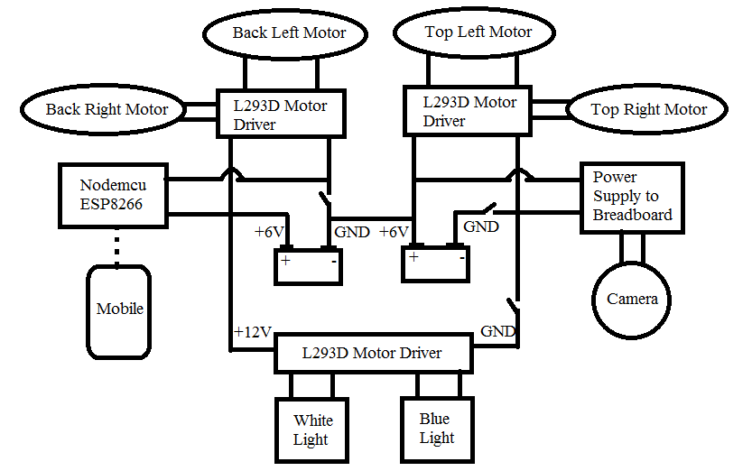
BLOCK DIAGRAM

Slide 11
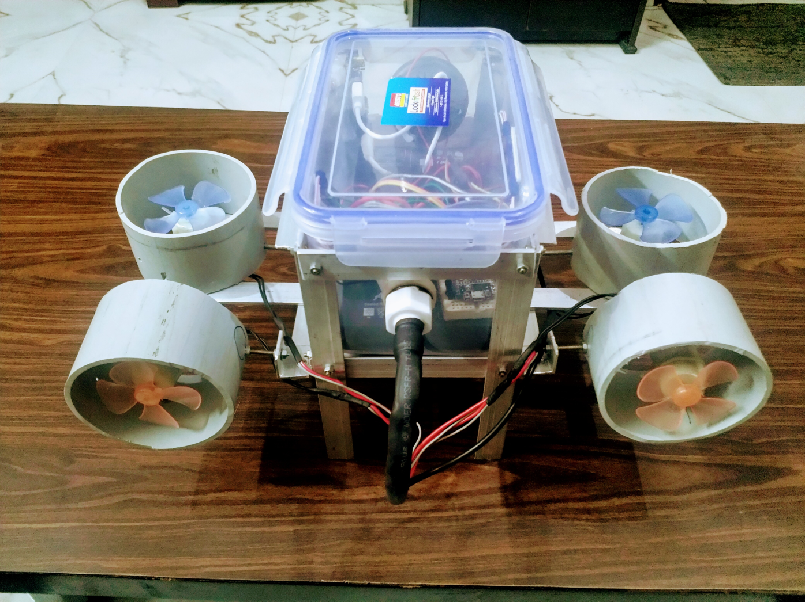
PHYSICAL 3D MODEL

Slide 12
FLOW CHART
Start
Send signal wireless module
No
If button is pressed
Yes
Wireless module Receive data
Microcontroller activates the motor to move
END

Slide 13
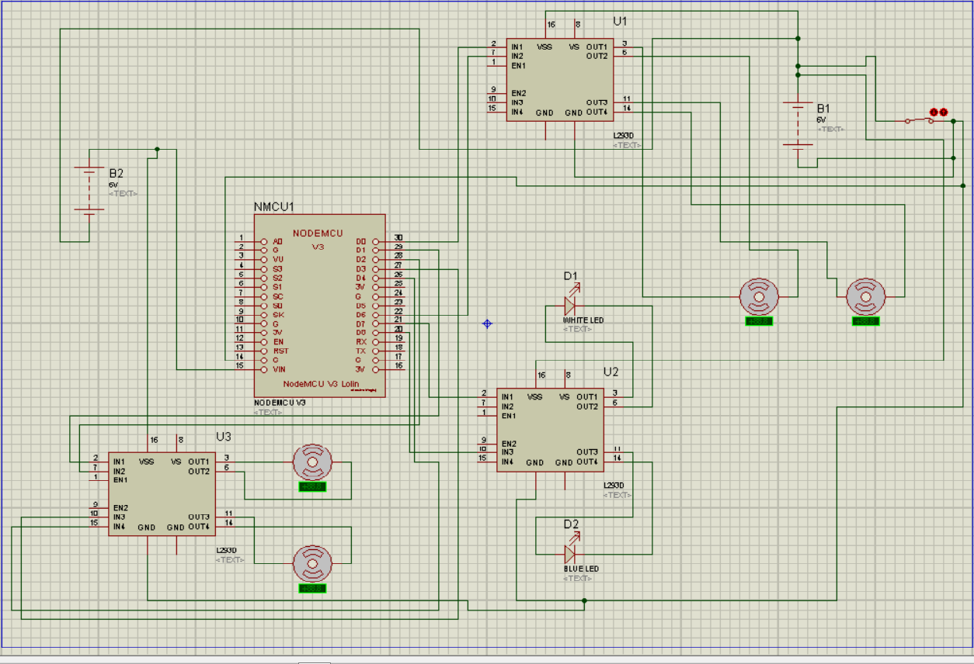
CIRCUIT DIAGRAM

Slide 14
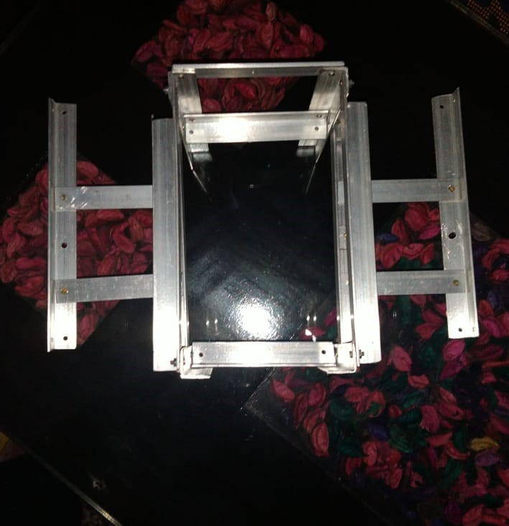
IMPLEMENTATION
Step 1: Designing the structure of ROV.

Slide 15
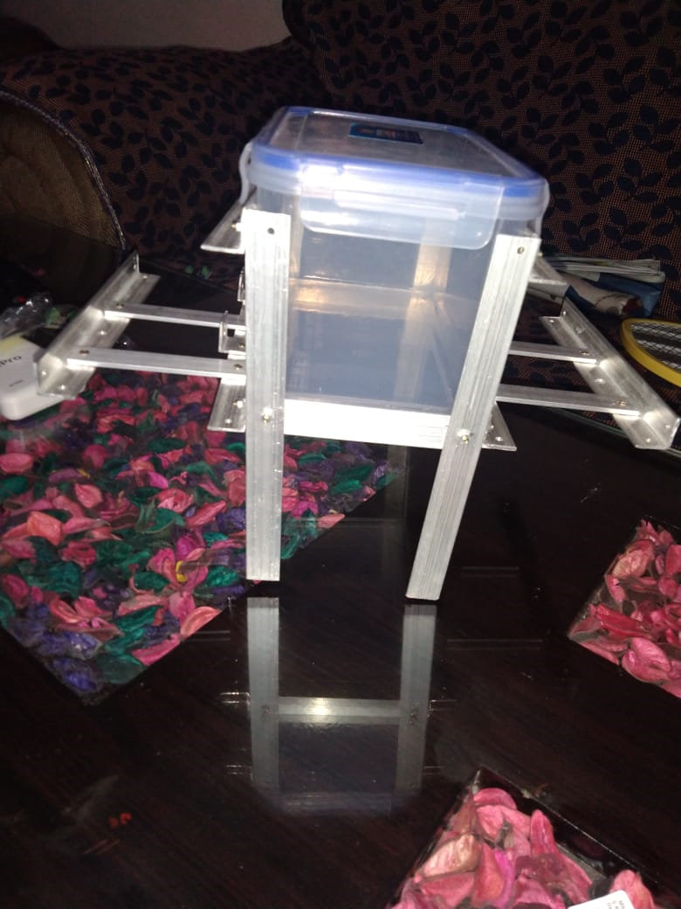
Step 2: The Structure attached with the water tight box.

Slide 16
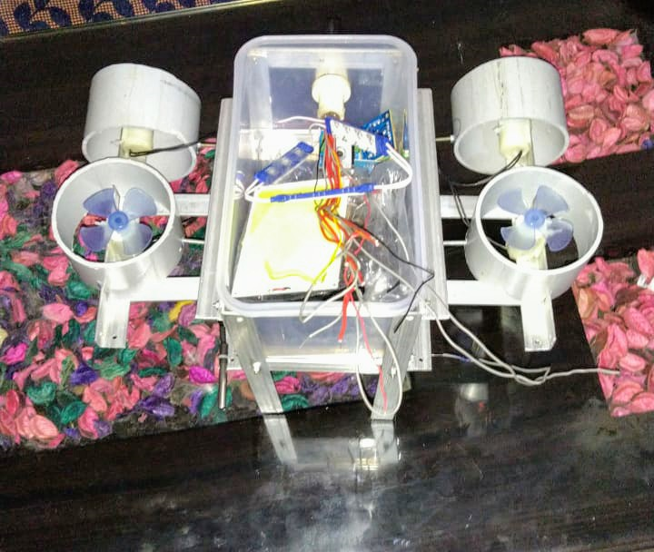
Step 3: The whole connection of components installed in the box.

Slide 17
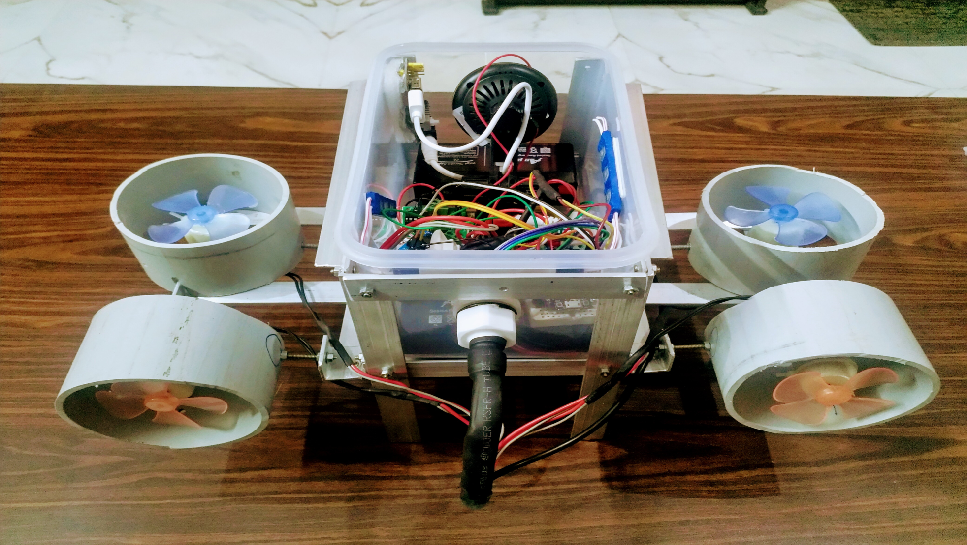
Step 4: The wire of Motors and temperature sensor inserted through tube to make the water resistant box.

Slide 18
ADVANTAGE
Leakage detection in deep sea oil pipes.
Spying with minimum human involvement.
Measuring temperature
Cost effective.

Slide 19
APPLICATIONS
These types of ROVs can help us understand the marine life in a better way.
Can be used for search and rescue operations.
To assist the underwater divers.
To know the ideal areas for fishing.
To monitor the sea beds and to preserve and clean the water bodies.

Slide 20
FUTURE SCOPE
In future these ROVs can involve a machinery to pick up the waste in water bodies
To enhance the range of ROV
To involve a mechanism that can cut the nets in which aquatic species get entangled.
The ROV can also be disguised for spying purposes.
Improve the specifications of ROV.

Slide 21
Gantt chart
Task name | Duration | Development
3D MODEL FORMATION | AUGUST 2019 | Selection of 3D Model was behind schedule and was finalised by September 2nd week.
CUTTING THE FRAME STRUCTURE | SEPTEMBER 2019 | The frame of ROV was setup and completed by end of September.
TESTING OF COMPONENTS | SEPTEMBER 2019 | LED panels, propulsion system and other components were tested.
SELECTION OF WATERPROOF BOX | OCTOBER 2019 | A light weight, portable and semi translucent box was tested to be waterproof.
PLACING COMPONENTS IN BOX | OCTOBER 2019 | Microcontroller, batteries along with other components were placed inside the box
TESTING OF CAMERA | NOVEMBER 2019 | Wifi camera was installed and working was checked.

Slide 22
GANTT CHART CONTINUED
ATTACHING MOTORS | NOVEMBER 2019 | Motors were attached to the frame and connected to the microcontroller.
WATERPROOFING | NOVEMBER 2019 | Waterproofing of the box was done.

Slide 23
REFERENCES
[1] R. D. Christ and R. L. Wernli, The ROV Manual - A User Guide for Remotely Operated Vehicles The ROV Manual A User Guide for Remotely, 2nd ed. Elsevier, 2014.
[2] M. S. Mohd Aras, M. N. Kamarudin, M. H. Bin Che Rusli, and M. I. Mohd Zainal, “Small scale unmanned underwater remotely operated crawler (ROC),” Indones. J. Electr. Eng. Comput. Sci., vol. 3, no. 3, pp. 481–488, 2016.
[3] F. A. Azis, M. S. M. Aras, M. Z. A. Rashid, M. N. Othman, and S. S. Abdullah, “Problem identification for Underwater Remotely Operated Vehicle (ROV): A case study,” J. Procedia Eng., vol. 41, pp. 554–560, 2012.
[4] R. Wiryadinata, A. S. Nurliany, I. Muttakin, and T. Firmansyah, “Design of a Low Cost Remotely Operated Vehicle with 3 DoF Navigation,” Bull. Electr. Eng. Informatics, vol. 6, no. 1, pp. 13–23, 2017.

Slide 24
THANK YOU

